Slide 1

Sales Analysis

Slide 2
Introduction
This project analyzes Amazon’s Diwali sales data to understand customer behaviour, feedback, and sales performance. Using Python for data cleaning and exploratory analysis, and Power BI for interactive dashboard creation, it uncovers insights on revenue trends, customer ratings, discount impact, and delivery performance to support data-driven business decisions.

Slide 3
Tech & Skills
Python
Power Bi
Pandas, NumPy
Matplotlib, Seaborn
EDA, Data Cleaning
Business Insights
Dashboard Design
DAX, Data Modelling
KPIs, Slicers
Visual Storytelling

Slide 4
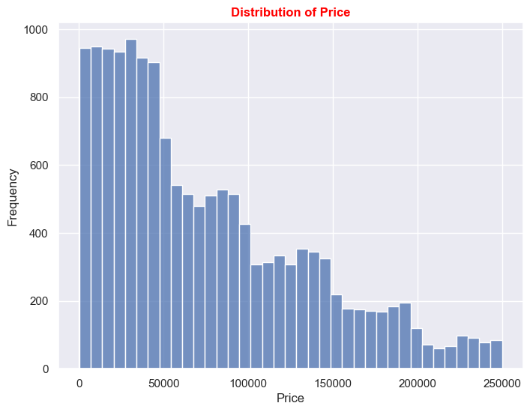
Distribution of Price
Right-skewed distribution → majority revenue comes from a small number of high-value orders.
Normal range orders produce consistent but smaller sales.

Slide 5
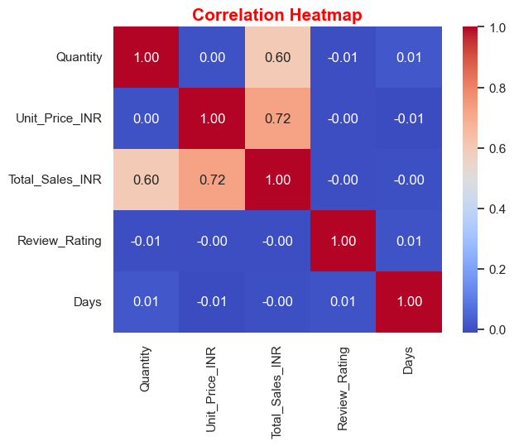
Correlation Heatmap
Strong correlations:
Unit_Price_INR ↔ Total_Sales_INR (0.72)
Higher-priced items contribute more to revenue.
Quantity ↔ Total_Sales_INR (0.60)
Total sales increase when more units are purchased.
No correlation:
Review_Rating has no relationship with revenue.
Days does not affect pricing, reviews, or total sales.

Slide 6
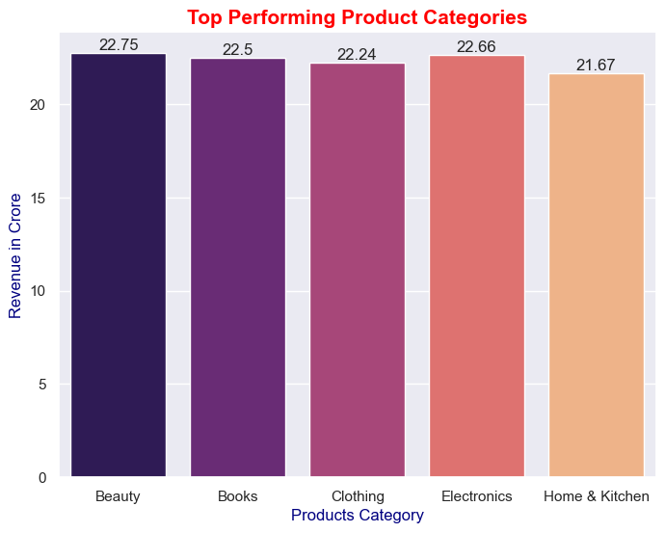
Top Performing Product
⭐ Beauty (₹22.75 Cr)
Highest revenue — strong demand for personal care & festive gifting items.
⭐ Books (₹22.50 Cr)
Strong performance due to gifting, education, and learning-related demand.
⭐ Clothing (₹22.24 Cr)
Steady apparel purchases during festive season.
⭐ Electronics (₹22.66 Cr)
High-value electronics drive major festive purchases.
⭐ Home & Kitchen (₹21.67 Cr)
Consistent demand for practical household essentials.

Slide 7
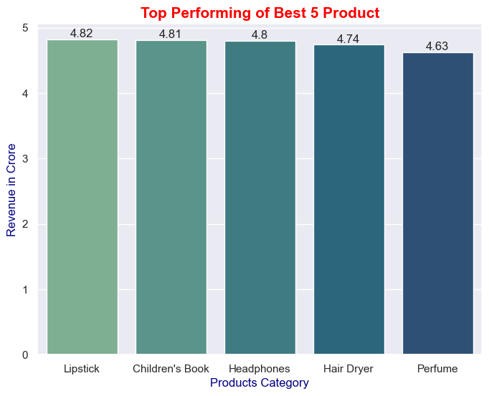
Top Performing of Best 5 Products
1. Lipstick – ₹4.82 Cr
Top-selling product → Beauty category dominated smaller-value purchases.
2. Children’s Book – ₹4.81 Cr
Very high demand among parents; popular as a gifting item.
3. Headphones – ₹4.80 Cr
Festive electronics purchase with strong discount impact.
4. Hair Dryer – ₹4.74 Cr
Grooming products in high demand during festive seasons.
5. Perfume – ₹4.63 Cr
Classic gifting product with strong performance.

Slide 8
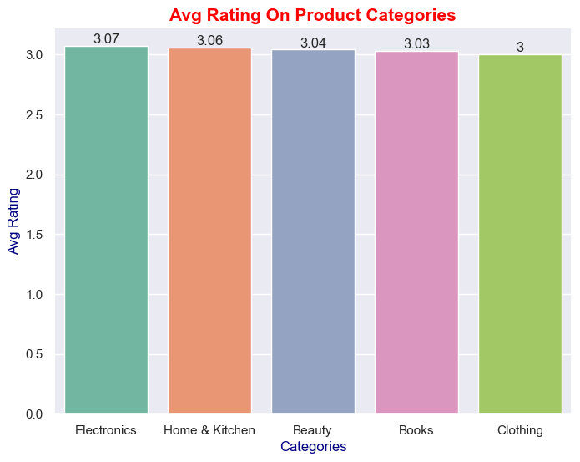
Average Rating on Product Categories
Beauty & Home & Kitchen products receive higher ratings, showing strong customer satisfaction.
Electronics have moderate ratings, possibly due to quality or delivery issues.

Slide 9
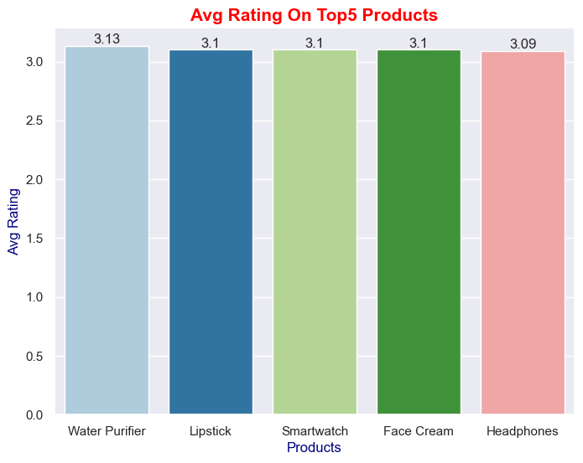
Average Rating on Top 5 Products
Books and personal care items have consistently high ratings.
Gadgets show mixed ratings based on quality/durability feedback.

Slide 10
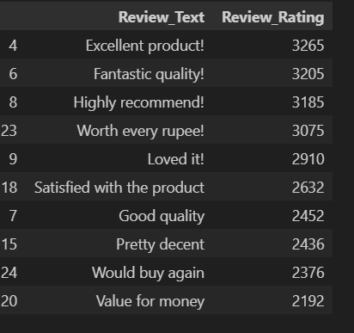
Review Text Analysis
Top reviews indicate:
“Excellent product”, “Fantastic quality”, “Highly recommend” — strong trust indicators.
Positive sentiment dominates feedback.

Slide 11
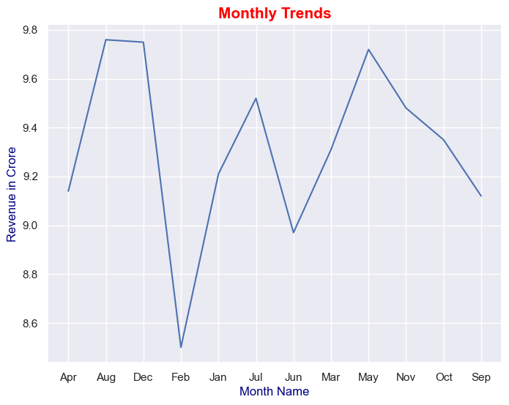
Monthly Sales Trends
Highest sales in August, December, and November.
Festive months drive peak revenue.

Slide 12
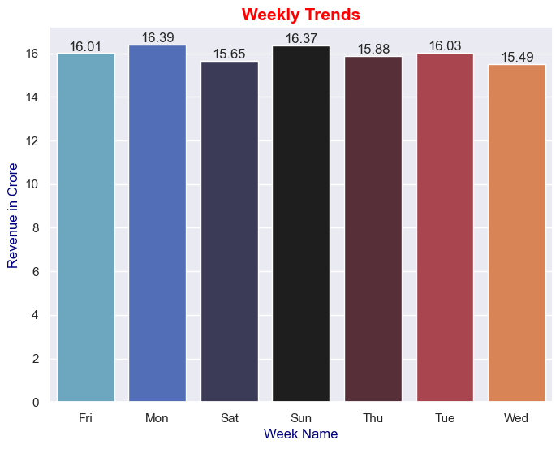
Weekly Sales Trends
Monday and Sunday generate the highest revenue.
Wednesday shows lowest sales.

Slide 13
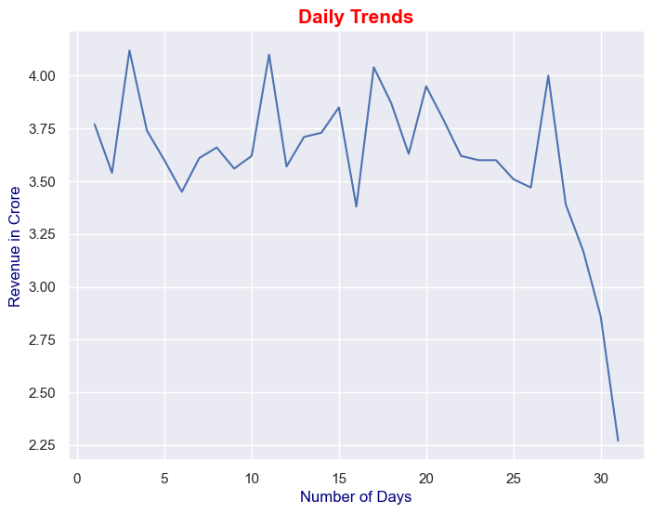
Daily Sales Trends
Revenue remains consistent across the month → no daily spikes.

Slide 14
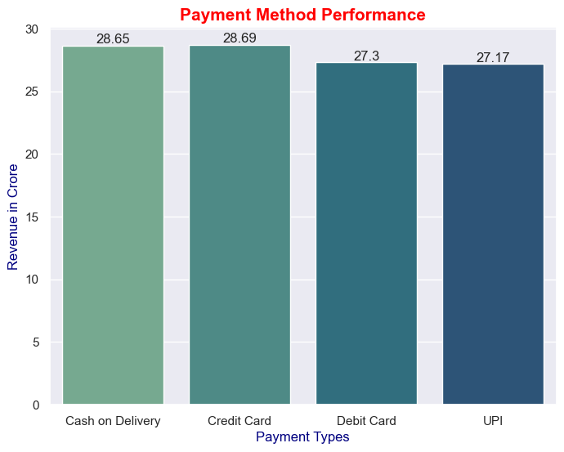
Payment Method Performance
Highest Revenue:
Credit Card (₹286.89 Cr)
Cash On Delivery (₹286.51 Cr)
Debit Card (₹273.04 Cr)
UPI (₹271.72 Cr)

Slide 15
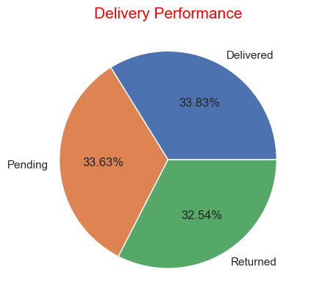
Delivery Performance
Delivered: 5075 orders (highest)
Pending: 5044 orders (almost equal)
Returned: 4881 orders

Slide 16
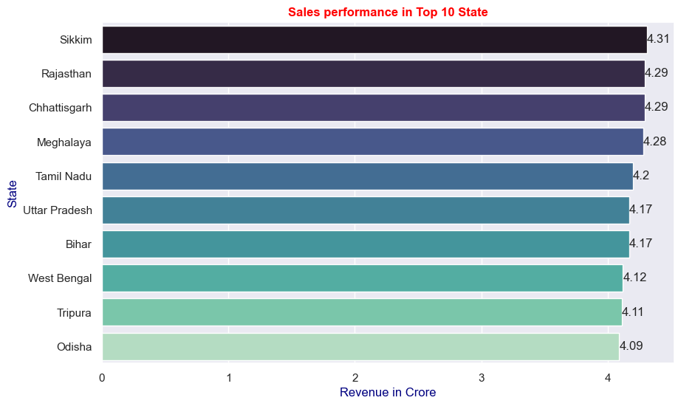
Sales Performance in Top 10 State
Top States by Revenue:
Maharashtra
Karnataka
Tamil Nadu
Uttar Pradesh
West Bengal

Slide 17
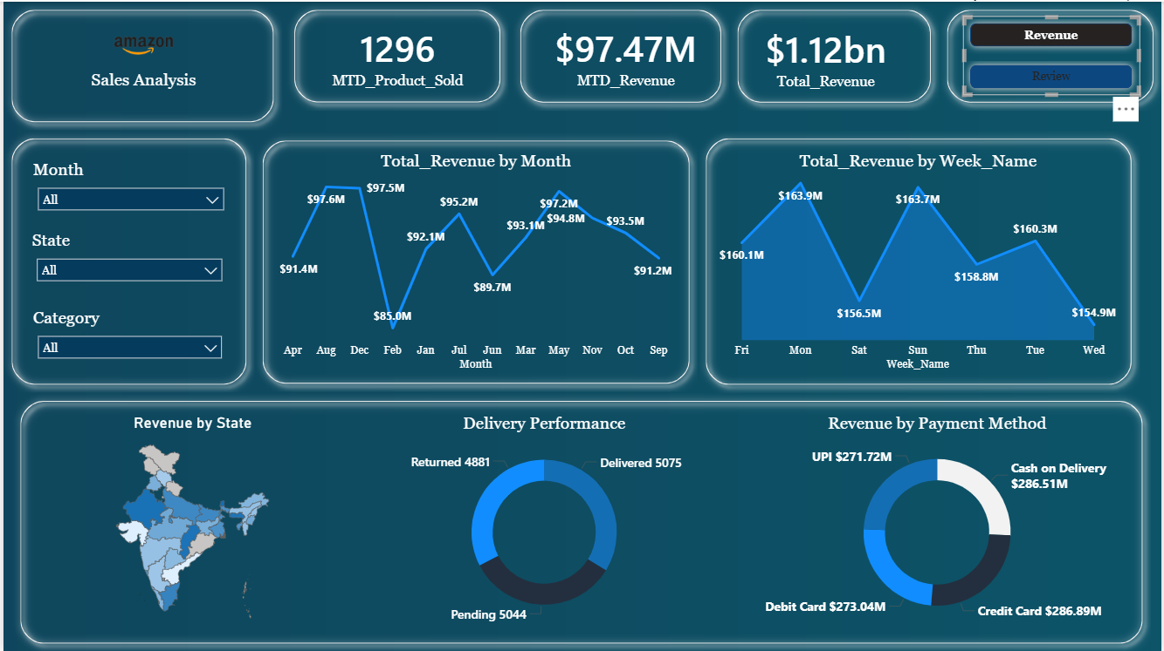
Revenue Dashbord

Slide 18
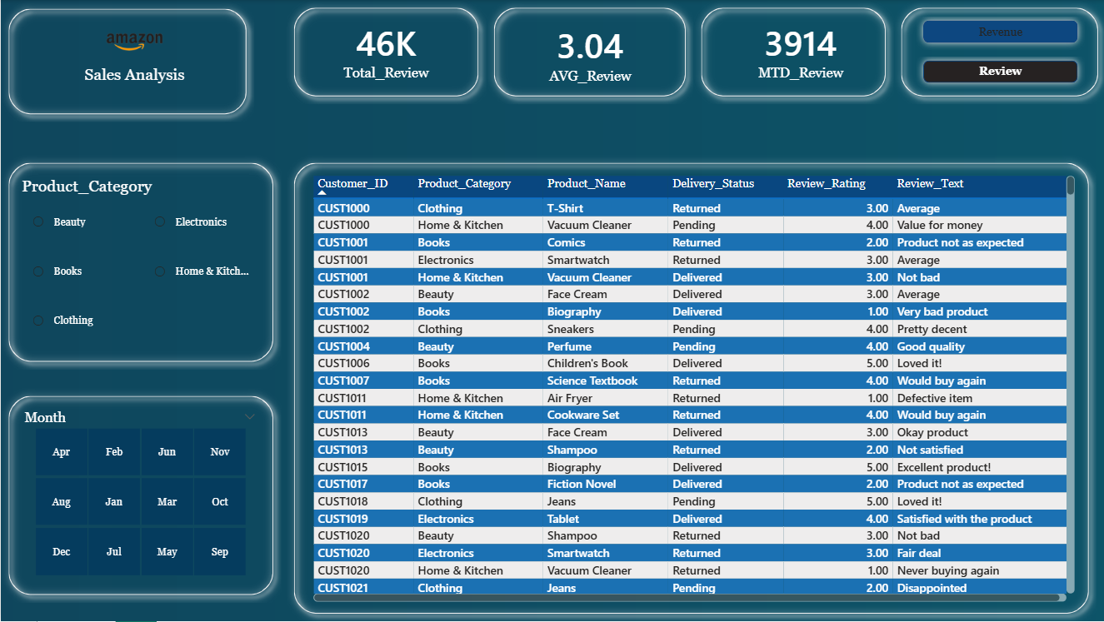
Review Dashboard

Slide 19
Business Insights
Amazon’s sales show strong performance across key categories with high customer engagement. Revenue is driven mainly by premium-priced and high-quantity orders, while customer feedback stays largely positive. Major states and payment methods contribute consistently to sales. However, high pending/returned orders highlight a need for improved delivery and logistics efficiency.

Slide 20
Thank You!

